Slide 1
Lecture 09 Introduction to Complexity of An Algorithm

Slide 2
What you will learn in this lecture:
What is an algorithm?
Why do we need to analyze an algorithm?
Introduction to growth function
Introduction to complexity of algorithm
Big-Oh, Big-Omega, and Big-Theta Notation
Mathematical approach
Analysis of algorithm

Slide 3
Algorithms
Algorithms are sequences of steps defined, developed, and used to solve a problem.
Examples of its usage:
Generating the orderings of a finite set
Searching a list
Sorting the terms of a sequence
Finding shortest path in a network
One important consideration concerning algorithm is its computational complexity.
Complexity of an algorithm refers to the amount of time or space needed to execute a given algorithm by:
Time efficiency: how fast an algorithm runs.
Space efficiency: the space an algorithm requires.

Slide 4
Big-Oh, Big-Omega, Big-Theta Notation
In computer science, O-, Ω-, and Θ- notations are introduced to analyze the efficiency of algorithms.
The notations provide approximations that make it easy to evaluate large-scale differences in algorithm efficiency, while ignoring differences of a constant factor and differences that occur only for small sets of input data.
O - notation
Ω - notation
Θ - notation
This is read as “Big-Oh” notation.
This is read as “Big-Omega” notation.
This is read as “Big-Theta” notation.

Slide 5
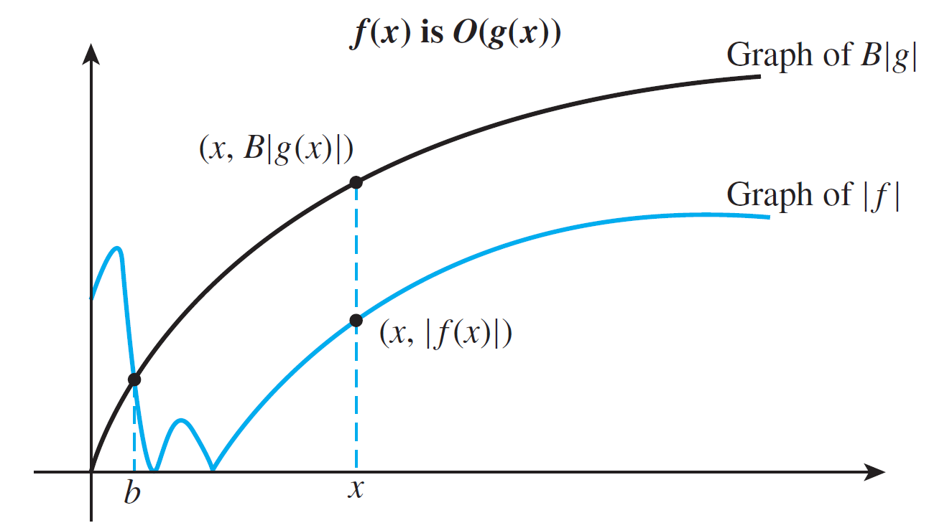
O - Notation
Definition:
Let f and g be functions from a set of integers or the set of real numbers to the set of real numbers.
We say that f (n) is O(g(n)), if there are constants B and b such that,
|f (n)| ≤ B |g(n)|
whenever n > b.
The constants B and b can be viewed as witnesses to the relationship of f (x) to O(g(x)) as shown in the graph.

Slide 6
Example 1
Show that is O(n²).
Solution:
when
Hence is O(n²).
|f(n)| =|3n²| = 3|n²| ≤ 3 |n²|
n > 0
You could select a value larger than 3 as coefficient for |n²|
according to the definition, but it is sufficient to define with the smallest value.

Slide 7

Example 2
Show that is $O\left(n^{7}\right)$.
Solution:
We consider
Hence $f\left(n\right) \text{is} O(n^{7})$

Slide 8
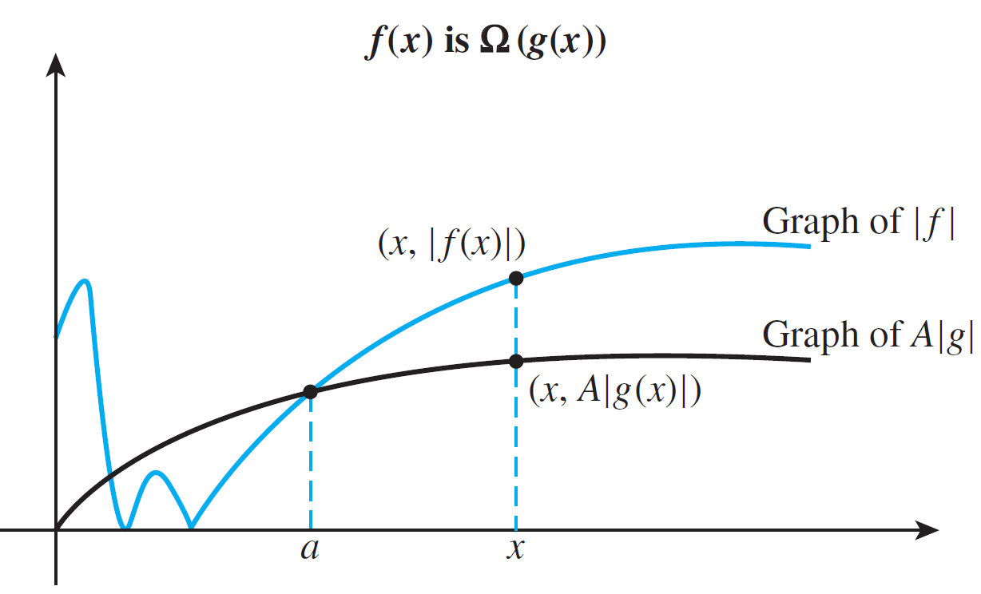
Ω - Notation
Definition:
Let f and g be functions from a set of integers or the set of real numbers to the set of real numbers.
We say that f (n) is Ω(g(n)) if there are constants A and a such that,
|f (n)| ≥ A |g(n)|
whenever n > a.
The constants A and a can be viewed as witnesses to the relationship of f (x) to Ω(g(x)) as shown in the graph.

Slide 9
Example 3
Show that is .
Solution:
Consider

Slide 10
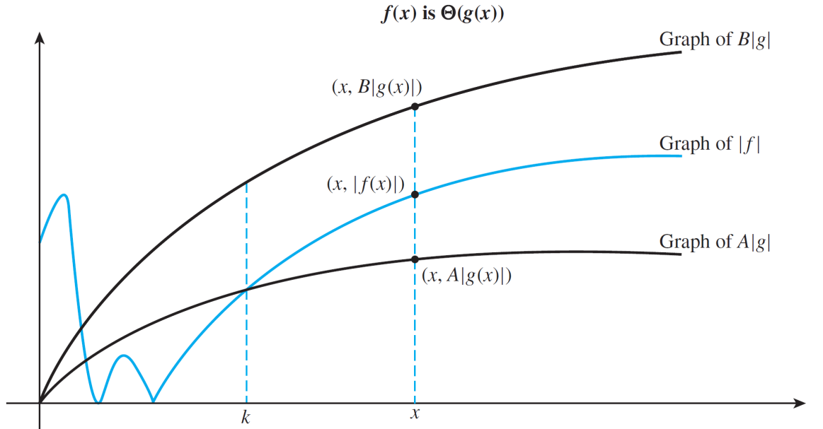
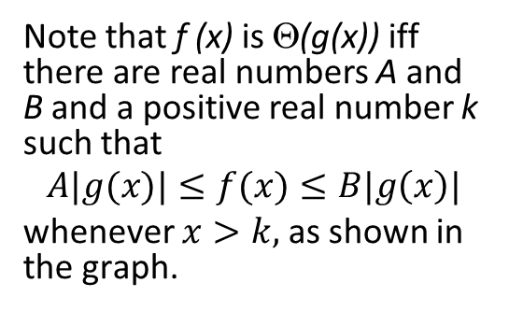
Θ - Notation
Definition:
Let f and g be functions from a set of integers or the set of real numbers to the set of real numbers.
We say that f (n) is Θ(g(n)) if f (n) is Ω(g(n)) and f (n) is O(g(n)).
Note that f (x) is Θ(g(x)) iff there are real numbers A and B and a positive real number k such that
$$A|g(x)|≤f(x)≤B|g\left(x\right)|$$
whenever $x>k,$ as shown in the graph.

Slide 11
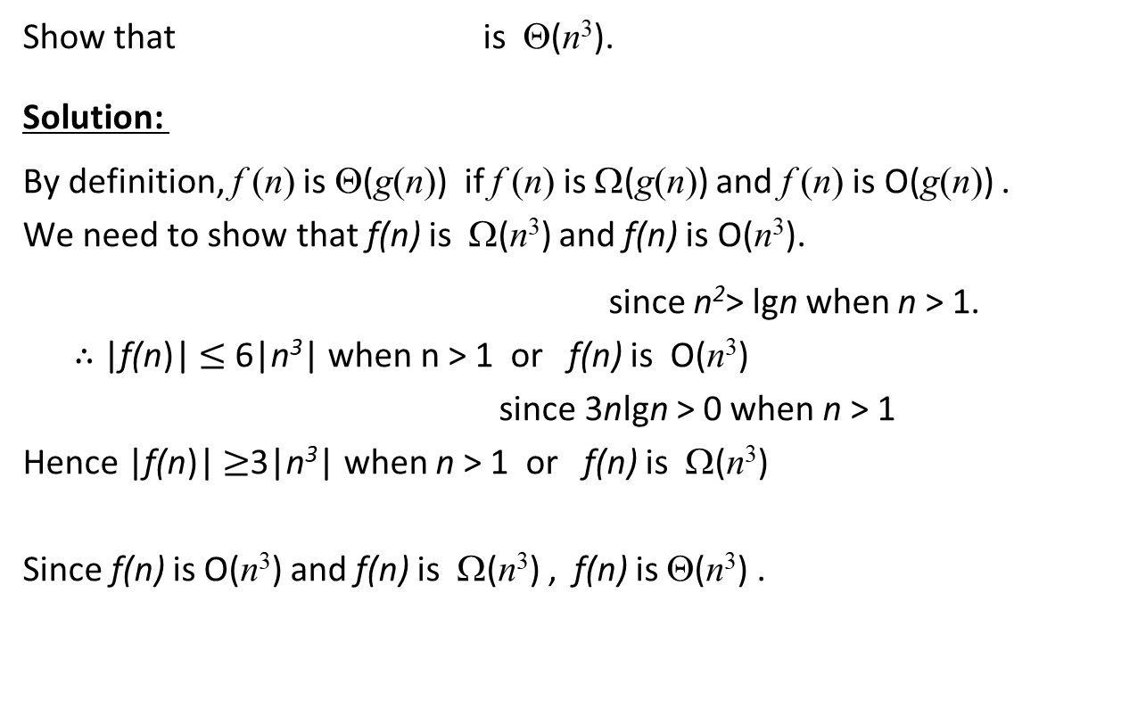
Example 4
Show that is Θ(n³).
Solution:
By definition, f (n) is Θ(g(n)) if f (n) is Ω(g(n)) and f (n) is O(g(n)) .
We need to show that f(n) is Ω(n³) and f(n) is O(n³).
since n²> lgn when n > 1.
$∴$ |f(n)| $≤$ 6|n³| when n > 1 or f(n) is O(n³)
since 3nlgn > 0 when n > 1
Hence |f(n)| $≥$3|n³| when n > 1 or f(n) is Ω(n³)
Since f(n) is O(n³) and f(n) is Ω(n³) , f(n) is Θ(n³) .
|f(n)|= |3n³ + 3nlgn| ≤ |3n³ + 3n³|
|3n³ + 3nlgn| ≥ 3|n³+0|

Slide 12
Big-Oh, Big-Omega, Big-Theta Notation
When f(x) is O(g(x)), we have an upper bound, in terms of g(x), for the size of f(x) for large values of x.
When f(x) is Ω(g(x)), we have a lower bound, in terms of g(x), for the size of f(x) for large values of x.
When f(x) is Θ(g(x)), we have both upper bound and lower bound, in terms of g(x), for the size of f(x) for large values of x.

Slide 13
Mathematical Approach
Given some function f (n) that describes an algorithm, you have to find another function g(n) by selecting some parts of the function f (n) that decides the growth of function f (n).
Mathematically, this is done by either:
removing the residual terms from a polynomial function (normally these are the constant and/or the low order terms in the polynomial),
maximizing all the terms in a polynomial function.

Slide 14
Analysis of An Algorithm
In computer science, a correct algorithm might not be efficient if the time or space taken for its execution is too large.
Analysis of an algorithm refers to the process of deriving the estimates of the complexity (or growth function) for the time and/or space needed to execute an algorithm.
An analysis table is usually used to determine the growth function (in time) for predicting the execution time of an algorithm and deriving the complexity of the algorithm.

Slide 15
Analysis of An Algorithm
Commonly used terminology for the complexity of algorithms.
Complexity | Terminology
Θ(1) | Constant complexity
Θ(logn) | Logarithmic complexity
Θ(log(logn)) | Log log complexity
Θ(n) | Linear complexity
Θ(nlogn) | Log linear complexity
Θ(n²) | Quadratic complexity
Θ(n^{m}) where interger m>1 | Polynomial complexity
Θ(c^{n}) where interger n>1 | Exponential complexity
Θ(n!) | Factorial complexity

Slide 16
Simple Algorithm Analysis
Example 5:
1 System.in.readln(x); c₁
2 System.out.writeln(x); c₂
Solution: Let f(n) denotes the time complexity to the code fragment
f(n) = c₁ + c₂ ⇒ f(n) is Θ(n⁰)
Example 6: Find the theta notation for the time complexity of the statement “x:=5” being executed in the following code fragment
1 for (int i = 1; i <= 10; i++)
{
2 x := 5; 10c₁
}
Solution: f(n) = 10c₁ ⇒ f(n) is Θ(n⁰)
Execution time
(the constant C is 1).
Input size is n.
Line
number
Execution time with constant
10 when the Input size is n.
What are the values of O and Ω of each f(n) above?

Slide 17
Example 7
Find the theta notation for time complexity of the statement “System.in.readln(x)” being executed in the following code fragment
int sum;
1 sum := 0;
2 for (int i = 1; i <= n; i++)
{
3 System.in.readln(x); n*c
4 sum := sum + x;
}
5 System.out.println(sum)
Solution: f(n) = nc ⇒ f(n) is Θ(n)

Slide 18
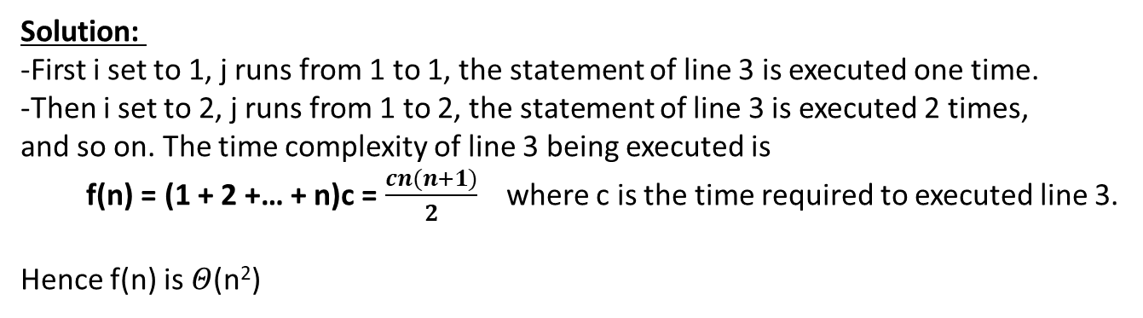
Example 8
Find the theta notation in terms of n for the time complexity of the statement
“sum := sum + F[i,j]” being executed in the following code fragment.
1 for (int i = 1; i <= n; i++)
2 for (int j = 1; j <= i; j++)
3 sum := sum + F[i,j];
Solution:
-First i set to 1, j runs from 1 to 1, the statement of line 3 is executed one time.
-Then i set to 2, j runs from 1 to 2, the statement of line 3 is executed 2 times,
and so on. The time complexity of line 3 being executed is
f(n) = (1 + 2 +… + n)c = $\frac{cn(n+1)}{2}$ where c is the time required to executed line 3.
Hence f(n) is $Θ$(n²)

Slide 19
Summary
We have learnt the following concepts related to the complexity of an algorithm:
Big-Oh
Big-Omega
Big-Theta
Mathematical approach to estimate the complexity of an algorithm.
Simple algorithm analysis using an analysis table.

Slide 20
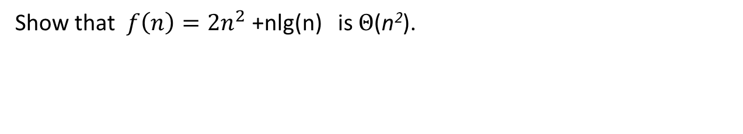
Exercise 1
Show that $f\left(n\right)=2n^{2}$ +nlg(n) is $Θ$(n²).
Solution:

Slide 21
Exercise 2
Find the theta notation in terms of n for the time complexity of the statement “sumsq= sumsq+ i*i” being executed in the following code fragment.
sumsq = 0;
i = 0;
(while i < n) {
sumsq= sumsq+ i*i;
i = i + 1;
}
Solution:

